Slide 1
TOPIC A1:
COMPUTER FUNDAMENTALS
HL ONLY
LESSON A1-9
TRANSLATION

Slide 2
AGENDA
Why translation exists
Compilers and interpreters
The autopsy
The bytecode
Translation time
Just-in-time
Choosing a translator
Lab
Close
WHAT U NEED 4 LESSON
Guided Notes
A pen
A calculator
Nothing else

Slide 3

THE WARM UP QUESTION
(a) State what is meant by a deadline in a control system [1]
(b) We are familiar with writing programs in Python. State what the CPU actually executes [1]
(c) State one reason the CPU cannot execute Python directly [1]
→ Notes Q1 (a), (b), (c)

Slide 4
THE WARM UP ANSWER
(a) The time by which the loop must finish, or the system has failed
(b) Machine code/assembly - binary instructions from its own instruction set
(c) The CPU only knows how to decode its own operations… The CPU runs 1s and 0s on Logic gates… etc.

Slide 5
WHY TRANSLATION EXISTS
Source code is what you write
  Machine code is what runs on the computer itself
    a.k.a. assembly
A translator turns one into the other
The reason we write code in Python, and not in assembly, is because it’s easier for us to understand , not because the CPU understands it
→ Notes Q2 (a), (b) and (c) [3 marks]

Slide 6
COMPILERS AND INTERPRETERS
A compiler translates the whole program from source code into machine code, then it runs the program
  Languages with compilers: C/++, Java, C#, lots of boomer languages
An interpreter translates and runs one statement at a time
  BASIC, Javascript, etc.
Compliers do all of the work up front, and interpreters do it as the program goes
Python is a mixture of the two: it compiles when you run it, but the script you launch is recompiled every time
  Only modules you import keep their compiled code, they are .pyc files

Slide 7
COMPILERS AND INTERPRETERS
The IB lists these as the main differences between compilers and interpreters
→ Notes Q3 (a) and (b) [4 marks]
 | Compiler | Interpreter
Error detection | Before it runs | When it reaches the line
Translation time | Once, up front | Every single run
Portability | One build per platform | Source runs on any platform
Applicability | Performance-critical | Rapid development

Slide 8
THE AUTOPSY
Here’s a receipt generator program
We’re going to modify one character of this program to demonstrate the different ways that Python handles its conversion
print("Opening the cash register...")
total = 0
for item in ["bread", "milk", "eggs"]:
total = total + 1
print("Scanned", item)
print("Items", total)
print("Thank you for shopping", customer_name)

Slide 9
THE AUTOPSY
Version A – remove the closing parenthesis on line 7
→ Notes Q4 (a) [1 mark] - how many lines print first?
print("Opening the cash register...")
total = 0
for item in ["bread", "milk", "eggs"]:
total = total + 1
print("Scanned", item)
print("Items", total)
print("Thank you for shopping", customer_name

Slide 10
THE AUTOPSY
Version B – run the code as is
→ Notes Q4 (b) [1 mark] - how many lines print first?
print("Opening the cash register...")
total = 0
for item in ["bread", "milk", "eggs"]:
total = total + 1
print("Scanned", item)
print("Items", total)
print("Thank you for shopping", customer_name)

Slide 11
THE AUTOPSY
Zero lines, then five lines. Same file, even though the error is from the same line
Python read the whole file and ‘compiled’ it before running line 1
Our mismatched parenthesis got caught then
  That is compile-time error detection
A wrong variable name is only caught when the line runs
  This is run-time error detection
→ Notes Q4 (c) [3 marks]

Slide 12
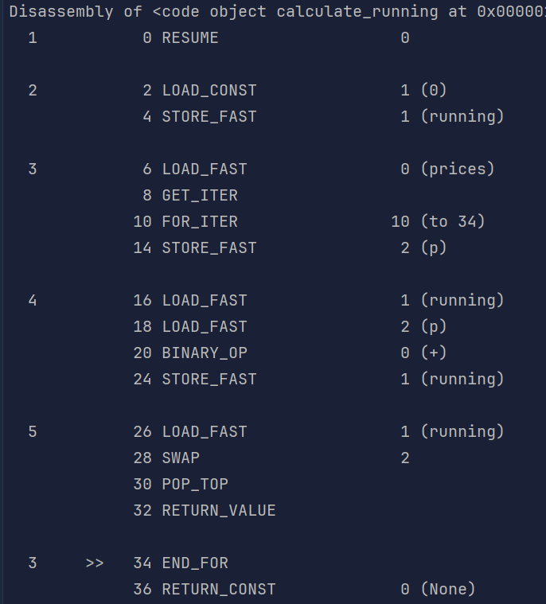
THE BYTECODE
def calculate_running(prices):
running = 0
for p in prices:
running = running + p
return running
If Python compiles first, there must be something it compiles to
It is called bytecode, and this is something we can actually see
python -m dis <insertscriptnamehere.py> prints it for any script
It is only saved for modules you import, not the script you run
→ Notes Q5 (a), (b) and (c) [4 marks]

Slide 13
THE BYTECODE
When you run a script in Python for the first time, it will compile into a .pyc file (python compiled), a bytecode file
  Windows hides these files by default
If you run the script again without changing it, Python will run that file instead
 | First run | Every run after
Time to import | 140 ms | 17 ms
What it does | Compiles, then runs | Reads the .pyc, runs
File on disk | bigmod.py 397 KB | bigmod.pyc 673 KB

Slide 14
THE BYTECODE
Measured on one laptop, on a 24,000-line script
The .pyc is BIGGER than the source, but it is much faster to run
→ Notes Q5 (d) [1 mark]
 | First run | Every run after
Time to import | 140 ms | 17 ms
What it does | Compiles, then runs | Reads the .pyc, runs
File on disk | bigmod.py 397 KB | bigmod.pyc 673 KB

Slide 15
TRANSLATION TIME
Compiling takes a of time for a CPU, relative to other actions
  But, it prevents us from distributing that time over and over again across runs
Assume compiling costs 900 ms, then each run costs 40 ms
And an interpreter costs 250 ms every single run, assuming it doesn’t cache any files
→ Notes Q6 (a) and (b) [4 marks]

Slide 16
TRANSLATION TIME
So who wins depends entirely on how many times you run it
→ Notes Q6 (c) [1 mark]
Runs | Compiled | Interpreted
1 | 940 ms | 250 ms
4 | 1060 ms | 1000 ms
5 | 1100 ms | 1250 ms
20 | 1700 ms | 5000 ms

Slide 17
TRANSLATION TIME
hMMM
This is an idea we’ve seen before, anyone remember where?
Runs | Compiled | Interpreted
1 | 940 ms | 250 ms
4 | 1060 ms | 1000 ms
5 | 1100 ms | 1250 ms
20 | 1700 ms | 5000 ms

Slide 18

TRANSLATION TIME
If you said ‘sorting a list before doing a binary search as compared to simply doing a linear search’ your brain works like mine does!
Runs | Compiled | Interpreted
1 | 940 ms | 250 ms
4 | 1060 ms | 1000 ms
5 | 1100 ms | 1250 ms
20 | 1700 ms | 5000 ms

Slide 19
JUST-IN-TIME
JIT compilation waits until the program is already running to decide what to compile
It watches which parts run often, then compiles only those to machine code
First pass is slow, and anything that runs frequently speeds up once it’s compiled
→ Notes Q7 (a) and (b) [3 marks]

Slide 20
CHOOSING A TRANSLATOR
Choosing the right option for the right problem
Scenario | Pick | Because
Rapid development and testing | Interpreter | No wait between edit and result
Performance-critical | Compiler | Translation already paid for
Cross-platform | Bytecode + JIT | One build, many machines

Slide 21
LAB
→ Notes Q8, Q9 and Q10 [8 marks] — silent, seven minutes
Q8 Explain why an interpreter suits rapid development and testing [3]
Q9 Explain why a compiled language is chosen for performance-critical work [2]
Q10 Evaluate a bytecode interpreter for a program that must run on Windows, macOS and Linux [3]

Slide 22

VOCABULARY TO REMEMBER
Source code
Machine code
Translator
Compiler
Interpreter
Compile time
Run time
Bytecode
Bytecode interpreter
.pyc
Just-in-time (JIT)
Error detection
Translation time
Portability
Applicability
Opcode

